Slide 1
Chapter 16
The High Renaissance in Italy, 1495–1520

Slide 2
Learning Objectives
Identify the stylistic characteristics shared across media by some of the world’s most famous artists.
Examine the conditions in which High Renaissance artists worked in Florence Rome and Venice.
Recognize the ancient sources of High Renaissance forms.
Consider the new themes and topics represented in High Renaissance art.
Interpret the meaning of the human figure for the High Renaissance.

Slide 3
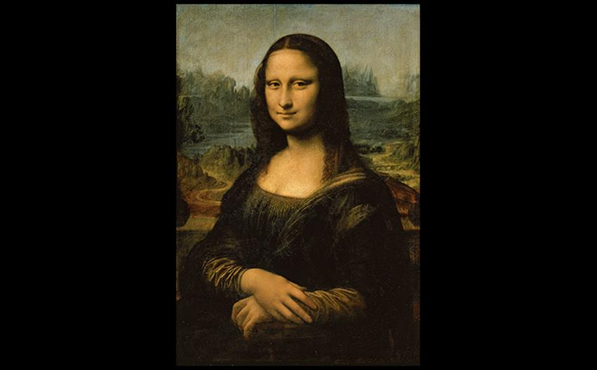
Leonardo da Vinci MONA LISA c. 1503–1506. Oil on wood panel, 30-1/4" × 21" (77 × 53 cm). Musée du Louvre, Paris. (INV. 779). Photo © RMN-Grand Palais (musée du Louvre)/Michel Urtado
Notes:
Leonardo da Vinci MONA LISA c. 1503–1506. Oil on wood panel, 30-1/4" × 21" (77 × 53 cm). Musée du Louvre, Paris. (INV. 779). Photo © RMN-Grand Palais (musée du Louvre)/Michel Urtado

Slide 4
Europe in the Sixteenth Century (1 of 2)
England, France, and Portugal started the century under strong monarchs.
German-speaking central Europe was divided, but acknowledged the Habsburg Holy Roman Emperor.
Popes behaved like secular princes, demanding money to finance the rebuilding of St. Peter's.

Slide 5
Europe in the Sixteenth Century (2 of 2)
Pope Clement VII directly clashed with Charles V and led to the Sack of Rome in May 1527.
Patrons valued artists highly and rewarded them with generous commissions as well as social status.
The humanist notion of arts as intellectual influenced and elevated artists, but favored men.

Slide 6
High Renaissance (Roman)
"High" constitutes an art-historical judgment in that this period set the standards for future movements.
This period fused the real and the ideal.
Oil painting became the preferred medium, and because commissions increased from private sources, artists no longer depended on the patronage of the Church.
Leonardo, Michelangelo, and Raphael all worked their early careers in Florence.

Slide 7
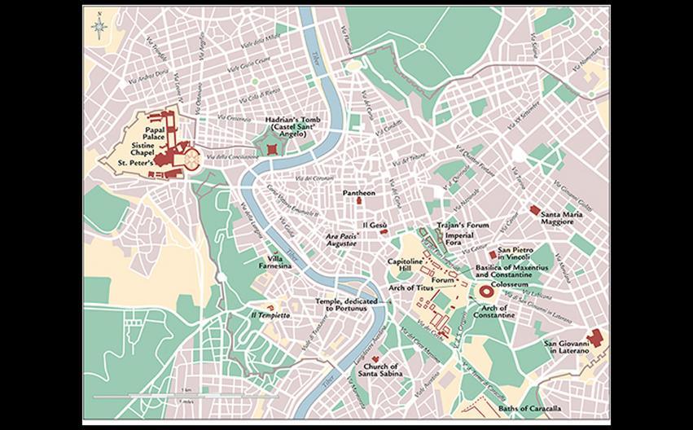
RENAISSANCE AND EARLIER MONUMENTS IN ROME In addition to situating the principal works of the Roman Renaissance that emerged from Julius II’s campaign to revitalize the papal city, this map also locates the surviving works of Roman antiquity that would have been available to the Renaissance artists and architects who masterminded the Classical revival.
Notes:
RENAISSANCE AND EARLIER MONUMENTS IN ROME

Slide 8
Leonardo da Vinci (1 of 4)
The Virgin of the Rocks shows four figures with strong chiaroscuro that enhances their modeling.
It is painted in the sfumato technique, creating a smoky effect.

Slide 9
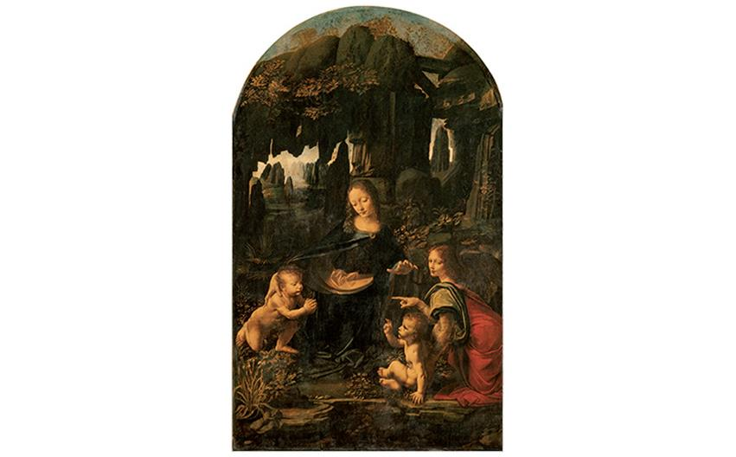
Leonardo da Vinci THE VIRGIN OF THE ROCKS c. 1485. Oil on wood panel (now transferred to canvas), 6'6" × 4' (1.9 × 1.2 m). Musée du Louvre, Paris. Photo © Réunion des Musés Nationaux/Musée du Louvre, Paris.
Notes:
Leonardo da Vinci THE VIRGIN OF THE ROCKS c. 1485. Oil on wood panel (now transferred to canvas), 6'6" × 4' (1.9 × 1.2 m). Musée du Louvre, Paris. Photo © Réunion des Musés Nationaux/Musée du Louvre, Paris.

Slide 10
Art and Its Contexts: The Vitruvian Man
Vitruvius, first-century BCE architect and engineer, inspired Leonardo da Vinci to seek ideal proportions of man.
He determined that ideal body height should be eight heads high.
Leonardo added his own observations to his well-known diagram of the ideal male figure, the Vitruvian Man.

Slide 11
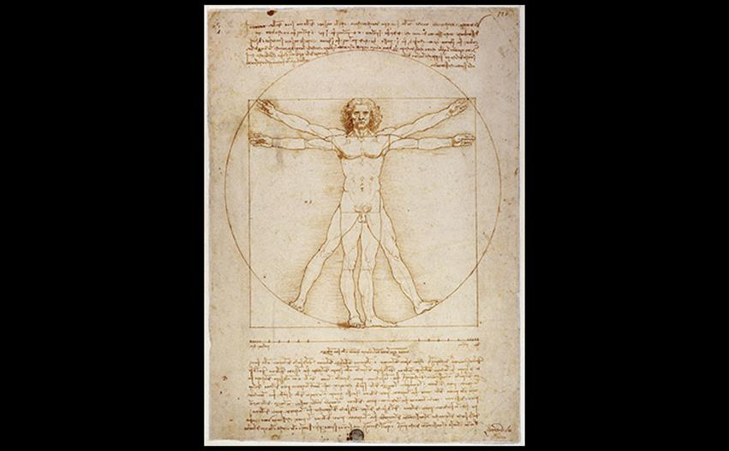
Leonardo da Vinci VITRUVIAN MAN c. 1490. Ink, 13-1/2" × 9-5/8" (34.3 × 24.5 cm). Galleria dell'Accademia, Venice. © Cameraphoto Arte, Venice.
Notes:
Leonardo da Vinci VITRUVIAN MAN c. 1490. Ink, 13-1/2" × 9-5/8" (34.3 × 24.5 cm). Galleria dell'Accademia, Venice. © Cameraphoto Arte, Venice.

Slide 12
Leonardo da Vinci (2 of 4)
The Last Supper, painted in the refectory of Sta. Maria delle Grazie, was a defining work of Renaissance art.
Leonardo arranged the disciples in four groups of three as they flank the stable, pyramidal form of Jesus in the middle.
The scene is set in stage-like recession, with the orthogonals converging at the head of Jesus.

Slide 13
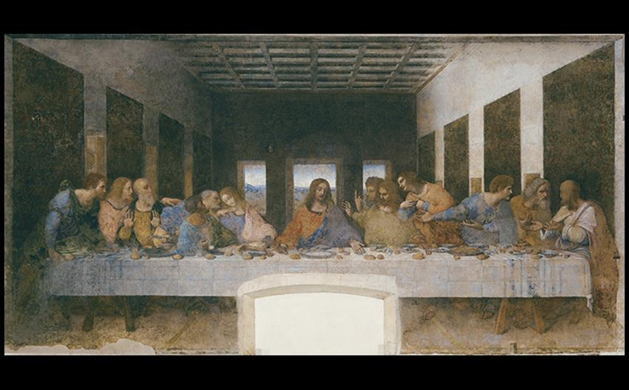
Leonardo da Vinci THE LAST SUPPER Refectory of the monastery of Santa Maria delle Grazie, Milan, Italy. 1495–1498. Tempera and oil on plaster, 15'2" × 28'10" (4.6 × 8.8 m). © Studio Fotografico Quattrone, Florence.
Notes:
Leonardo da Vinci THE LAST SUPPER Refectory of the monastery of Santa Maria delle Grazie, Milan, Italy. 1495–1498. Tempera and oil on plaster, 15'2" × 28'10" (4.6 × 8.8 m). © Studio Fotografico Quattrone, Florence.

Slide 14
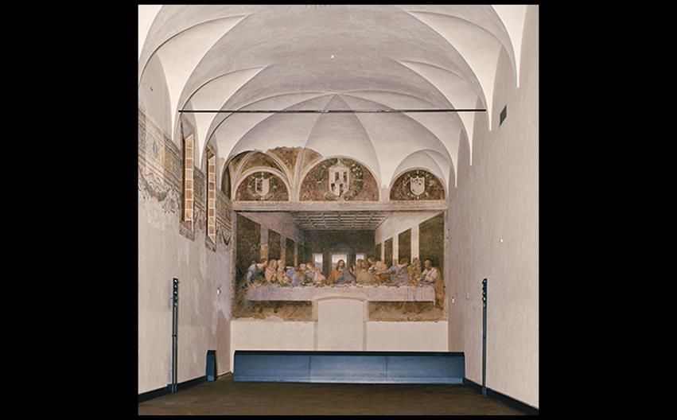
REFECTORY OF THE MONASTERY OF SANTA MARIA DELLE GRAZIE, SHOWING LEONARDO'S LAST SUPPER Milan, Italy. © Studio Fotografico Quattrone, Florence.
Notes:
REFECTORY OF THE MONASTERY OF SANTA MARIA DELLE GRAZIE, SHOWING LEONARDO'S LAST SUPPER Milan, Italy. © Studio Fotografico Quattrone, Florence.

Slide 15
Leonardo da Vinci (3 of 4)
The Mona Lisa is, perhaps, his most famous work, painted about 1503–1506.
The distant, hazy mountains give the subject, Lisa Gherardini del Giocondo, a mysterious quality.
Her direct stare and "enigmatic" smile add to the effect.

Slide 16
Leonardo da Vinci (4 of 4)
He insisted on the supremacy of painting over sculpture as being the best medium for creating an illusion of the world, but argued that color was second to volume.
Secondary interests included mathematics, engineering, and nature, which took him away from creating more work.

Slide 17
Raphael (1 of 4)
The Small Cowper Madonna typifies the artist's popular paintings of the Virgin and Child.
A pyramidal composition and clinging draperies show the influence of da Vinci.

Slide 18
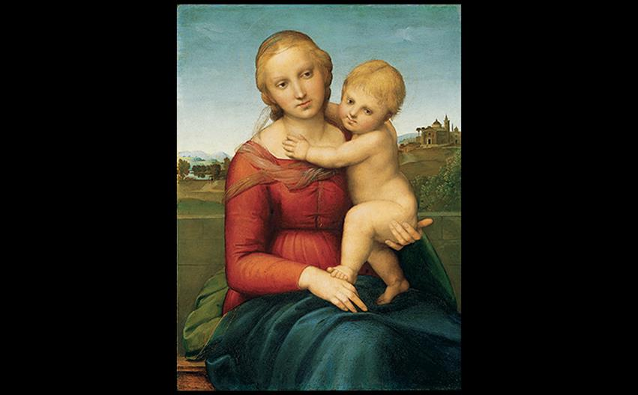
Raphael THE SMALL COWPER MADONNA c. 1505. Oil on wood panel, 23-3/8" × 17-3/8" (59.5 × 44.1 cm). National Gallery of Art, Washington, DC. Widener Collection (1942.9.57). Image courtesy the National Gallery of Art, Washington.
Notes:
Raphael THE SMALL COWPER MADONNA c. 1505. Oil on wood panel, 23-3/8" × 17-3/8" (59.5 × 44.1 cm). National Gallery of Art, Washington, DC. Widener Collection (1942.9.57). Image courtesy the National Gallery of Art, Washington.

Slide 19
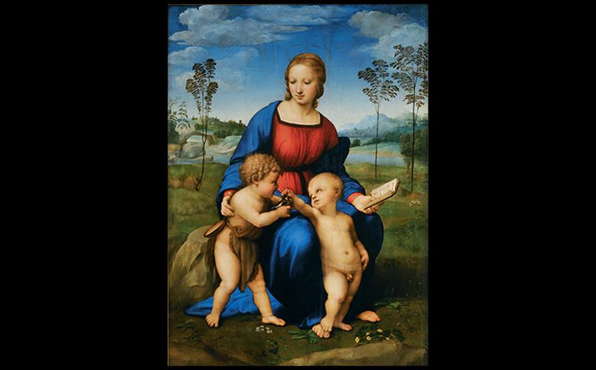
Raphael MADONNA OF THE GOLDFINCH (MADONNA DEL CARDELLINO) 1506. Oil on panel, 42 × 29-1⁄2″ (106.7 × 74.9 cm). Galleria degli Uffizi, Florence. © Studio Fotografico Quattrone, Florence.
Notes:
Raphael MADONNA OF THE GOLDFINCH (MADONNA DEL CARDELLINO) 1506. Oil on panel, 42 × 29-1⁄2″ (106.7 × 74.9 cm). Galleria degli Uffizi, Florence. © Studio Fotografico Quattrone, Florence

Slide 20
Raphael (2 of 4)
Pendant portraits were commissioned for prosperous Florentine.
The portraits of Maddalena and Agnelo show Raphael following tradition by making ostentatious display of jewelry despite a landscape similar to that behind the Mona Lisa.

Slide 21
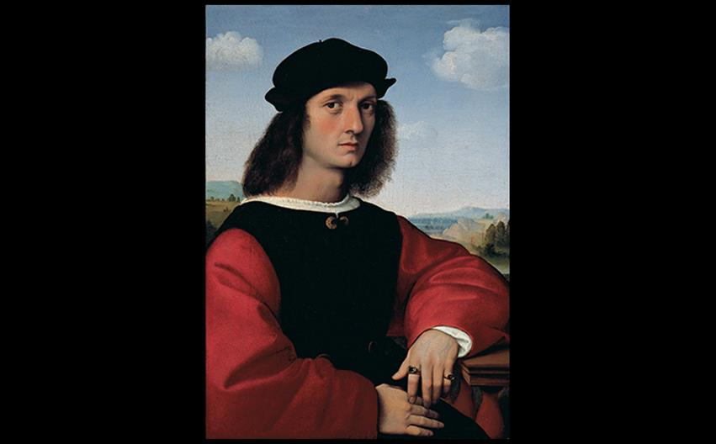
Raphael AGNELO DONI c. 1506. Oil on wood panel, each 24-1/2" × 17-1/4" (63 × 45 cm). Palazzo Pitti, Florence. © Studio Fotografico Quattrone, Florence.
Notes:
Raphael AGNELO DONI c. 1506. Oil on wood panel, each 24-1/2" × 17-1/4" (63 × 45 cm). Palazzo Pitti, Florence. © Studio Fotografico Quattrone, Florence.

Slide 22
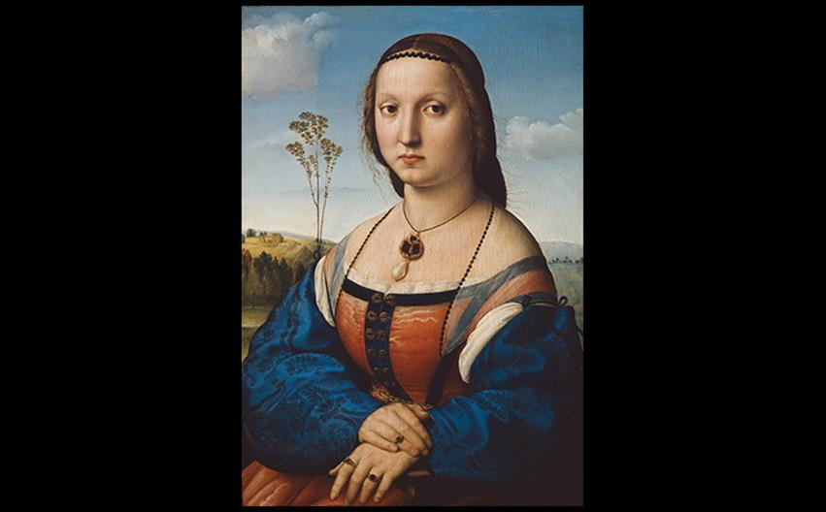
Raphael MADDALENA STROZZI c. 1506. Oil on wood panel, each 24-1/2" × 17-1/4" (63 × 45 cm). Palazzo Pitti, Florence. © Studio Fotografico Quattrone, Florence.
Notes:
Raphael MADDALENA STROZZI c. 1506. Oil on wood panel, each 24-1/2" × 17-1/4" (63 × 45 cm). Palazzo Pitti, Florence. © Studio Fotografico Quattrone, Florence.

Slide 23
Raphael (3 of 4)
Raphael's most influential work in the papal rooms was the School of Athens in the Stanza della Segnatura.
Harmoniously arranged forms and rational space complement the room in which it was painted.
Philosophical figures, while idealized, have dynamically foreshortened contrapposto poses.

Slide 24
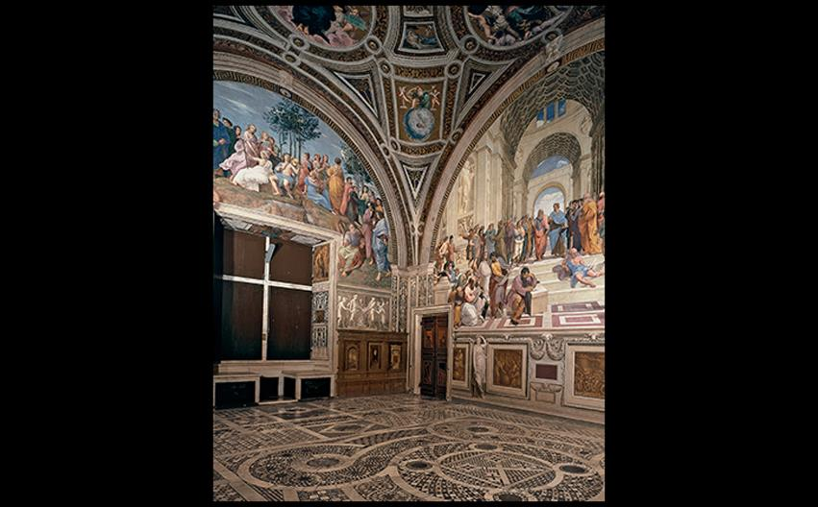
Raphael STANZA DELLA SEGNATURA Vatican, Rome. Fresco in the left lunette, Parnassus; in the right lunette, The School of Athens. 1510–1511. Photo © Musei Vaticani/IKONA.
Notes:
Raphael STANZA DELLA SEGNATURA Vatican, Rome. Fresco in the left lunette, Parnassus; in the right lunette, The School of Athens. 1510–1511. Photo © Musei Vaticani/IKONA.

Slide 25
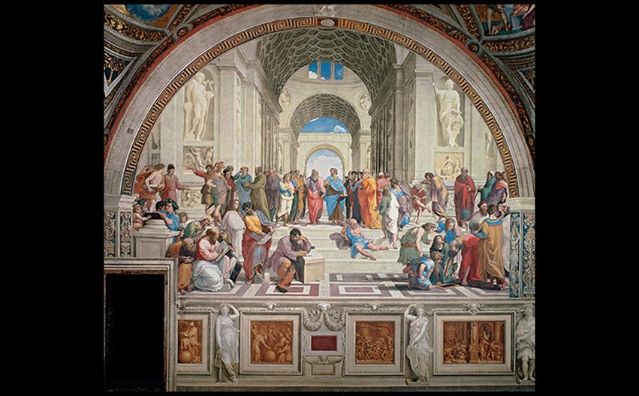
A CLOSER LOOK: The School of Athens by Raphael Fresco in the Stanza della Segnatura, Vatican, Rome. c. 1510–1511. 19' × 27' (5.79 × 8.24 m). Photo © Musei Vaticani/IKONA.
Notes:
A CLOSER LOOK: The School of Athens by Raphael Fresco in the Stanza della Segnatura, Vatican, Rome. c. 1510–1511. 19' × 27' (5.79 × 8.24 m). Photo © Musei Vaticani/IKONA.

Slide 26
Raphael (4 of 4)
Tapestries in the Sistine Chapel
The cartoons behind the set of ten tapestries for Leo X's commissions were created between 1515 and 1516.
Comparison between the cartoon studies and the tapestries reveals that weavers did not follow models slavishly.
The tapestries are displayed in the museum rather than in the chapel.

Slide 27
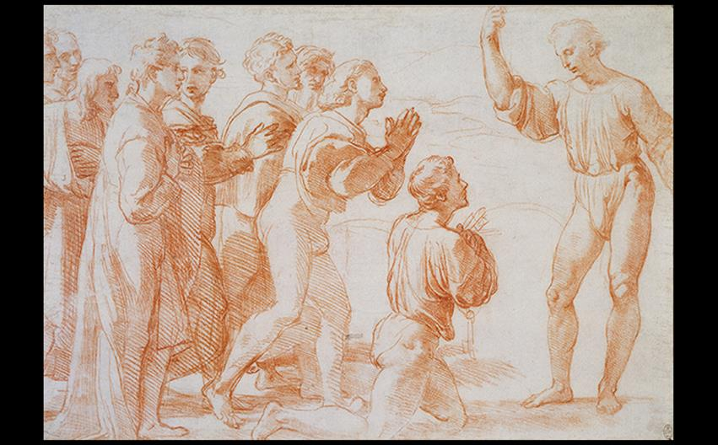
Raphael STUDY FOR CHRIST'S CHARGE TO PETER c. 1515. Red chalk. Royal Library, Windsor Castle. Royal Collection Trust © Her Majesty Queen Elizabeth II, 2016/Bridgeman Images.
Notes:
Raphael STUDY FOR CHRIST'S CHARGE TO PETER c. 1515. Red chalk. Royal Library, Windsor Castle. Royal Collection Trust © Her Majesty Queen Elizabeth II, 2016/Bridgeman Images.

Slide 28
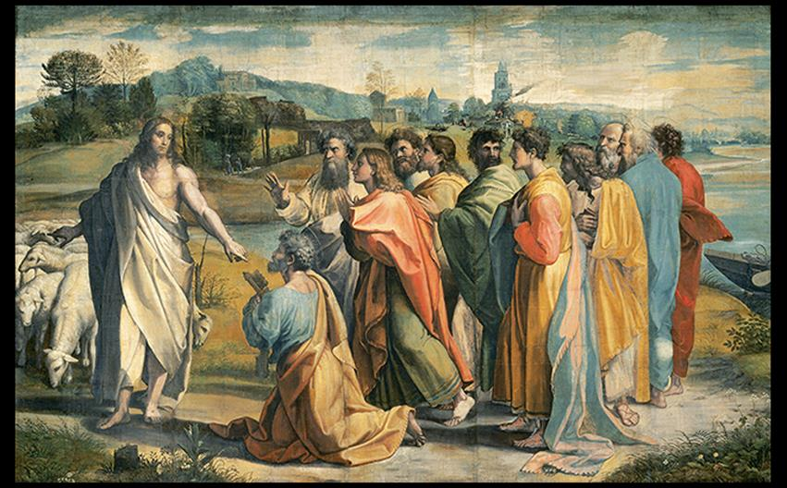
Raphael and assistants CARTOON FOR TAPESTRY PORTRAYING CHRIST'S CHARGE TO PETER c. 1515–1516. Distemper on paper (now transferred to canvas), 11'1" × 17'4" (3.4 × 5.3 m). Lent by Her Majesty the Queen to the Victoria & Albert Museum, London. V&A Images/Victoria and Albert Museum.
Notes:
Raphael and assistants CARTOON FOR TAPESTRY PORTRAYING CHRIST'S CHARGE TO PETER c. 1515–1516. Distemper on paper (now transferred to canvas), 11'1" × 17'4" (3.4 × 5.3 m). Lent by Her Majesty the Queen to the Victoria & Albert Museum, London. V&A Images/Victoria and Albert Museum.

Slide 29
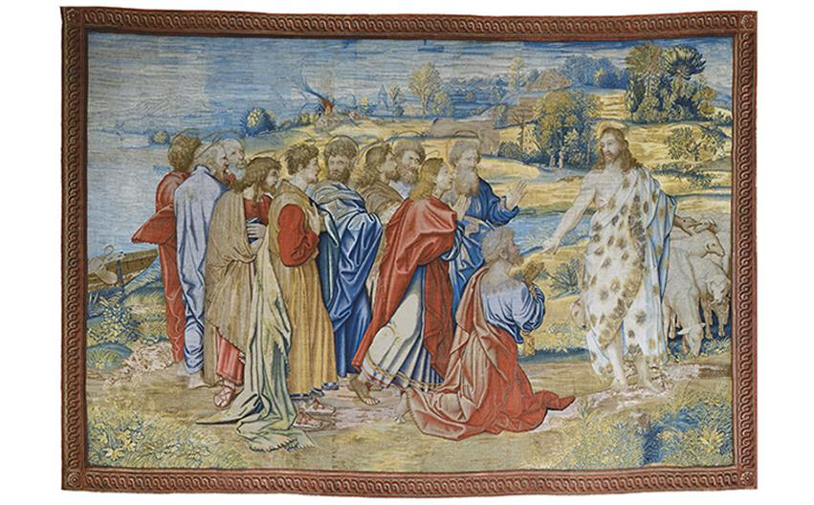
Shop of Pieter van Aelst, Brussels, after cartoons by Raphael and assistants CHRIST'S CHARGE TO PETER Woven 1517, installed 1519 in the Sistine Chapel. Wool and silk with silver-gilt-wrapped threads. Musei Vaticani, Pinacoteca, Rome. Photo © Musei Vaticani/IKONA.
Notes:
Shop of Pieter van Aelst, Brussels, after cartoons by Raphael and assistants CHRIST'S CHARGE TO PETER Woven 1517, installed 1519 in the Sistine Chapel. Wool and silk with silver-gilt-wrapped threads. Musei Vaticani, Pinacoteca, Rome. Photo © Musei Vaticani/IKONA.

Slide 30
Michelangelo (1 of 6)
An example of Michaelangelo's early work is the marble Pietà.
The subject of the Virgin supporting and mourning the dead Jesus was rare in Italian art of the time.
Size disparity between the large Virgin and Jesus is forgotten when viewing the smooth modeling of deftly carved forms.

Slide 31
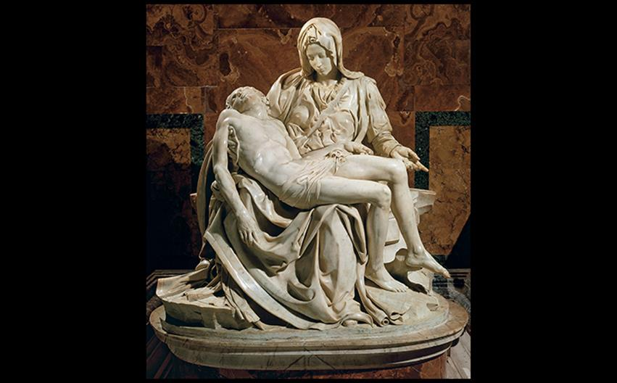
Michelangelo PIETÀ c. 1500. Marble, height 5'8-1/2" (1.74 m). St. Peter's, Vatican, Rome. Canali Photobank, Milan, Italy.
Notes:
Michelangelo PIETÀ c. 1500. Marble, height 5'8-1/2" (1.74 m). St. Peter's, Vatican, Rome. Canali Photobank, Milan, Italy.

Slide 32
Michelangelo (2 of 6)
The statue of David was commissioned for a buttress of a cathedral in Florence, but was so loved that it was placed in the city square instead.
The concentrated gaze departs from antique facial expression.

Slide 33
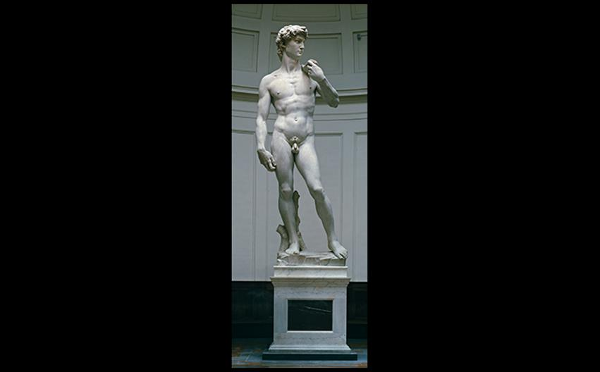
Michelangelo DAVID 1501–1504. Marble, height 17' (5.18 m) without pedestal. Galleria dell'Accademia, Florence. © Studio Fotografico Quattrone, Florence.
Notes:
Michelangelo DAVID 1501–1504. Marble, height 17' (5.18 m) without pedestal. Galleria dell'Accademia, Florence. © Studio Fotografico Quattrone, Florence.

Slide 34
Michelangelo (3 of 6)
The Ceiling of the Sistine Chapel
The Sistine Chapel ceiling was ordered by Pope Julius II, who wanted the theme to be the Twelve Apostles, which Michelangelo found too limiting.
Shallow bands of painted stone molding divide the vault into nine compartments showing scenes from Genesis.
The iconic Creation of Adam shows God sparking Adam with life.

Slide 35
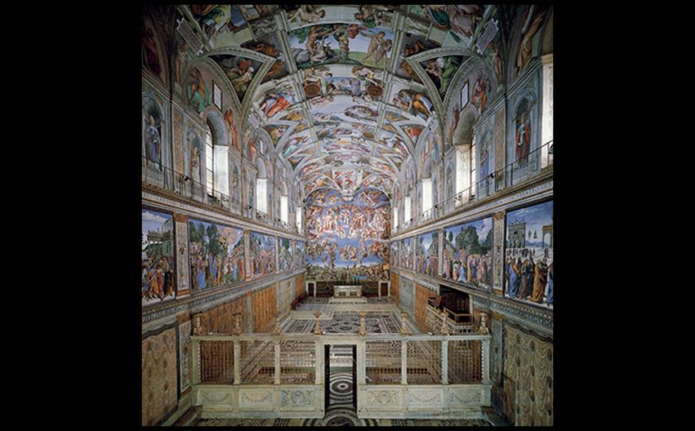
INTERIOR, SISTINE CHAPEL Vatican, Rome. Built 1475–1481; ceiling painted 1508–1512; end wall, 1536–1541. The ceiling measures 45 × 128' (13.75 × 39 m). Photo © Musei Vaticani/IKONA.
Notes:
INTERIOR, SISTINE CHAPEL Vatican, Rome. Built 1475–1481; ceiling painted 1508–1512; end wall, 1536–1541. The ceiling measures 45 × 128' (13.75 × 39 m). Photo © Musei Vaticani/IKONA

Slide 36
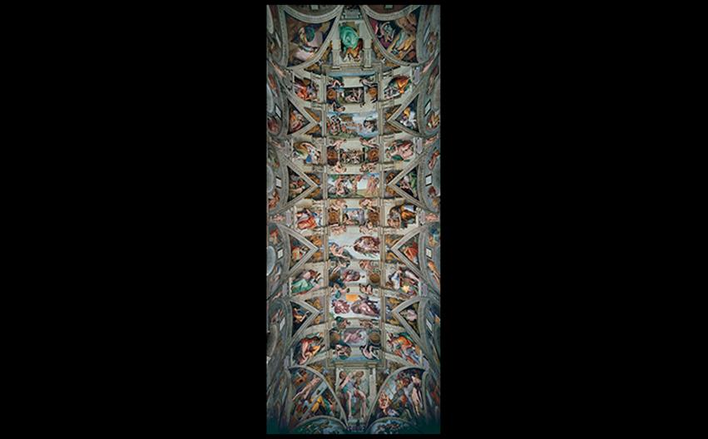
Michelangelo SISTINE CHAPEL CEILING WITH DIAGRAM IDENTIFYING SCENES 1508–1512. Fresco. Photo © Musei Vaticani/IKONA.
Notes:
Michelangelo SISTINE CHAPEL CEILING WITH DIAGRAM IDENTIFYING SCENES 1508–1512. Fresco. Photo © Musei Vaticani/IKONA.

Slide 37
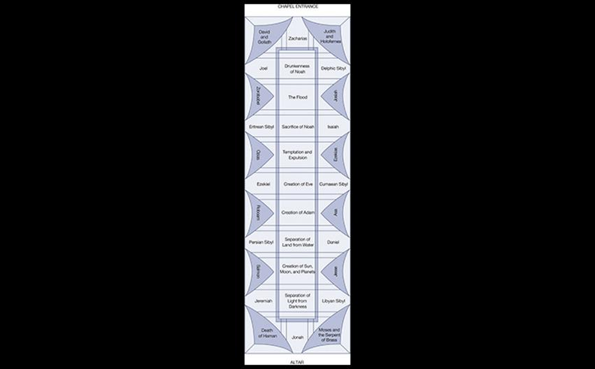
Michelangelo SISTINE CHAPEL CEILING WITH DIAGRAM IDENTIFYING SCENES 1508–1512. Fresco.
Notes:
Michelangelo SISTINE CHAPEL CEILING WITH DIAGRAM IDENTIFYING SCENES 1508–1512. Fresco.

Slide 38
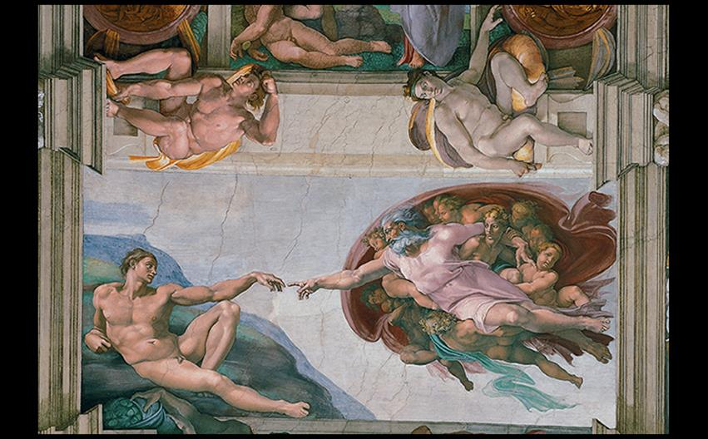
Michelangelo CREATION OF ADAM, SISTINE CHAPEL CEILING 1511–1512. Fresco, 9'2" × 18'8" (2.8 × 5.7 m). Photo © Musei Vaticani/IKONA.
Notes:
Michelangelo CREATION OF ADAM, SISTINE CHAPEL CEILING 1511–1512. Fresco, 9'2" × 18'8" (2.8 × 5.7 m). Photo © Musei Vaticani/IKONA.

Slide 39
Michelangelo (4 of 6)
The Ceiling of the Sistine Chapel
The Last Judgment wall was painted between 1536 and 1541 behind the altar of the Sistine Chapel.
The saved swarm around a central Christ, while the damned are guided by the demonic boatman Charon toward hell.

Slide 40
Michelangelo (5 of 6)
San Lorenzo
Michelangelo became the architect for the Medici family, creating two monuments with idealized portraits of the deceased.
Female and male figures atop the sarcophagi represent night and day.

Slide 41
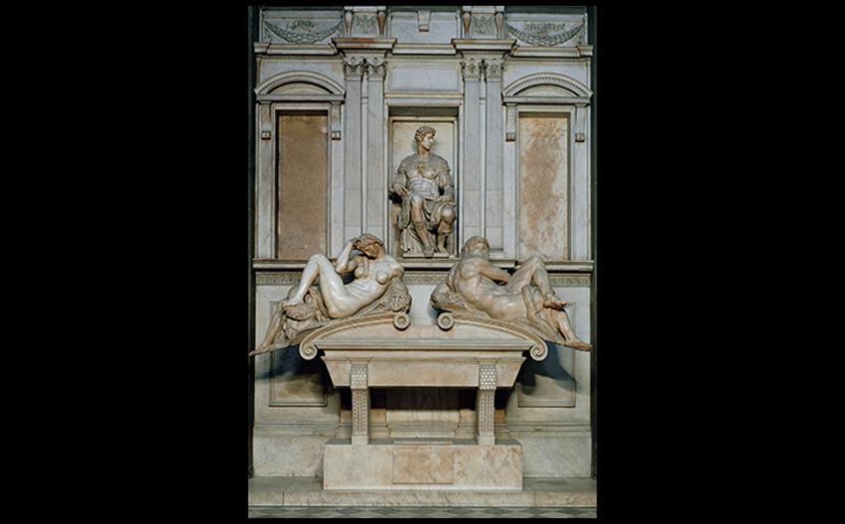
Michelangelo TOMB OF GIULIANO DE' MEDICI WITH ALLEGORICAL FIGURES OF NIGHT AND DAY New Sacristy (Medici Chapel), church of San Lorenzo, Florence. 1519–1534. Marble, height of seated figure approx. 5'10" (1.8 m). © Studio Fotografico Quattrone, Florence.
Notes:
Michelangelo TOMB OF GIULIANO DE' MEDICI WITH ALLEGORICAL FIGURES OF NIGHT AND DAY New Sacristy (Medici Chapel), church of San Lorenzo, Florence. 1519–1534. Marble, height of seated figure approx. 5'10" (1.8 m). © Studio Fotografico Quattrone, Florence.

Slide 42
Michelangelo (6 of 6)
San Lorenzo
Concurrent with the tombs was the construction of a new library, the vestibule of which designed by Michelangelo.
Columns are recessed into rectangular wall niches in a creative combination of architectural forms.
The forms are more important than the function, a Mannerist characteristic.

Slide 43
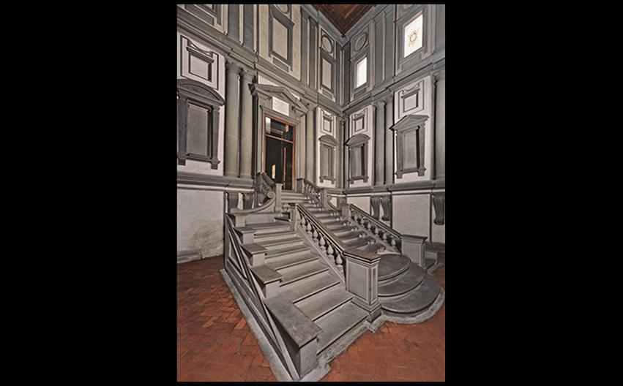
Michelangelo VESTIBULE OF THE LAURENTIAN LIBRARY Church of San Lorenzo, Florence. Begun 1524; stairway designed 1550s. © Studio Fotografico Quattrone, Florence.
Notes:
Michelangelo VESTIBULE OF THE LAURENTIAN LIBRARY Church of San Lorenzo, Florence. Begun 1524; stairway designed 1550s. © Studio Fotografico Quattrone, Florence.

Slide 44
Architecture in Rome and the Vatican
Pope Julius II enlisted Bramante, Raphael, and Michelangelo to carry out his vision of a revitalized Rome.
Bramante
Combining principles of Vitruvius and Alberti, Bramante created Il Tempietto over the spot where Peter was believed to have been crucified.

Slide 45
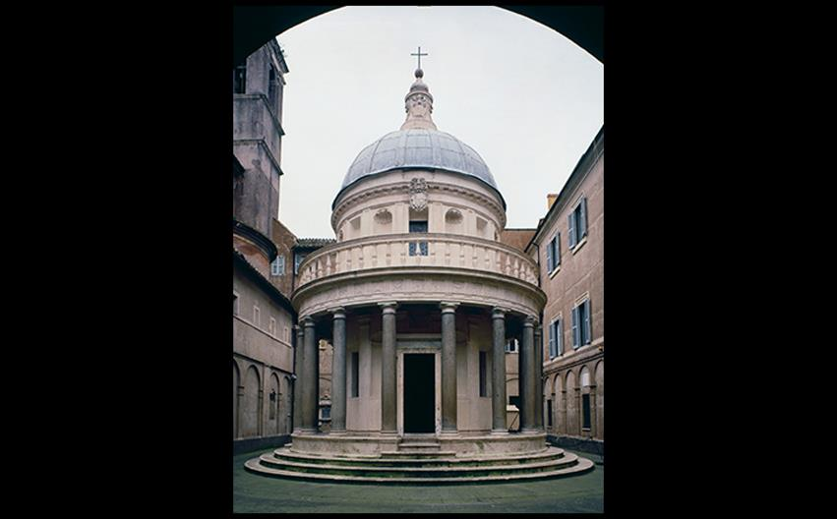
Donato Bramante IL TEMPIETTO, CHURCH OF SAN PIETRO IN MONTORIO Rome. 1502–1510; dome and lantern were restored in the 17th century. © Vincenzo Pirozzi, Rome
Notes:
Donato Bramante IL TEMPIETTO, CHURCH OF SAN PIETRO IN MONTORIO Rome. 1502–1510; dome and lantern were restored in the 17th century. © Vincenzo Pirozzi, Rome

Slide 46
Northern Italy (1 of 4)
Architects and painters working for wealthy patrons created fanciful structures and a colorful, illusionistic painting style.
Giulio Romano
Romano was commissioned to build a pleasure palace.
The design was full of visual jokes and did not include much residential space.

Slide 47
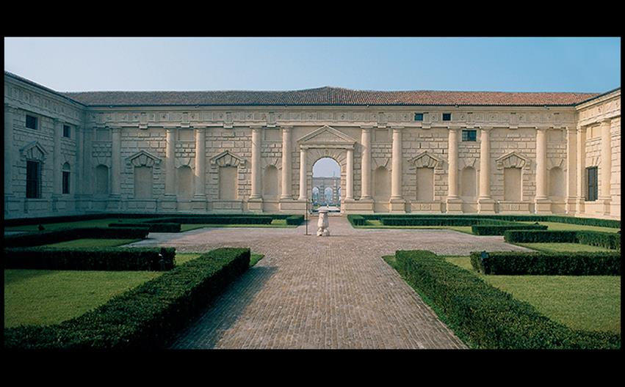
Giulio Romano COURTYARD FAÇADE, PALAZZO DEL TÈ, MANTUA 1527–1534. © SuperStock.
Notes:
Giulio Romano COURTYARD FAÇADE, PALAZZO DEL TÈ, MANTUA 1527–1534. © SuperStock.

Slide 48
Northern Italy (2 of 4)
Giulio Romano
Decoration of the two principal rooms continued witty designs in the Palazzo del Tè.
Unifying themes were love and politics.
Decoration reflected Federigo's dicey alliance with Charles V.

Slide 49
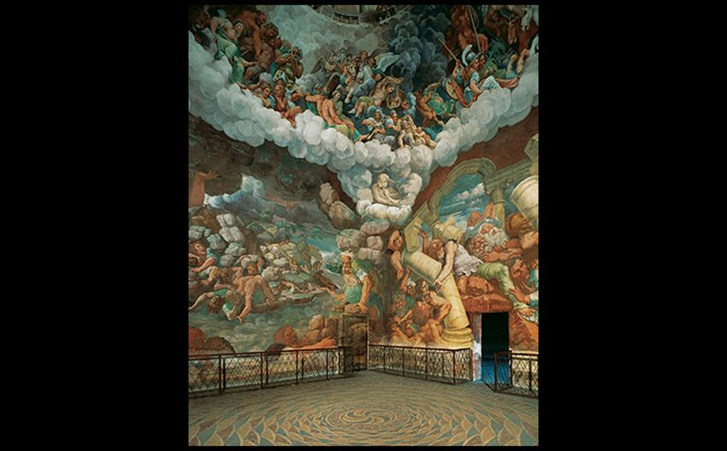
Giulio Romano FALL OF THE GIANTS Sala dei Giganti, Palazzo del Tè. 1530–1532. Fresco. © 2016. Photo Scala, Florence.
Notes:
Giulio Romano FALL OF THE GIANTS Sala dei Giganti, Palazzo del Tè. 1530–1532. Fresco. © 2016. Photo Scala, Florence.

Slide 50
Northern Italy (3 of 4)
Correggio
With use of dramatic foreshortening, Correggio creates the illusion that the ceiling is opening up in the Assumption of the Virgin.
It recalls Mantegna's ceiling in the Gonzaga palace, but utilizes da Vinci's sfumato and Raphael's idealism.

Slide 51
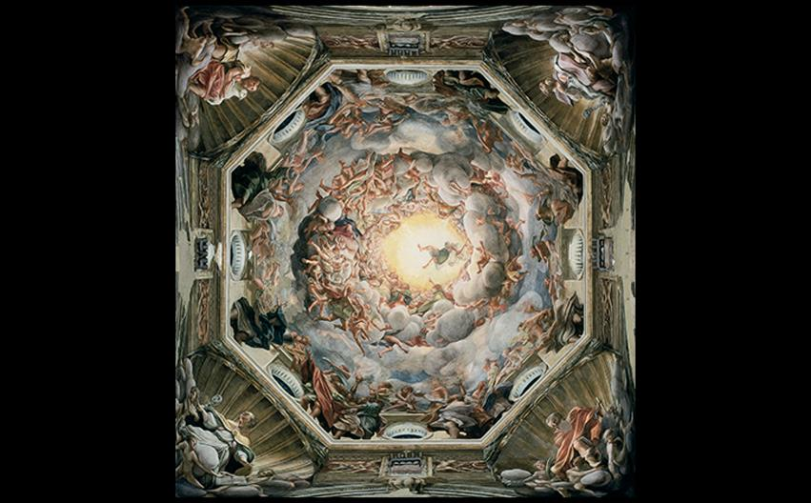
Correggio ASSUMPTION OF THE VIRGIN Main dome, interior, Parma Cathedral, Italy. c. 1526–1530. Fresco, diameter of base of dome approx. 36' (11 m). © 2016. Photo Scala, Florence.
Notes:
Correggio ASSUMPTION OF THE VIRGIN Main dome, interior, Parma Cathedral, Italy. c. 1526–1530. Fresco, diameter of base of dome approx. 36' (11 m). © 2016. Photo Scala, Florence.

Slide 52
Northern Italy (4 of 4)
Properzia de' Rossi
Properzia was the only woman included in Giorgio Vasari's 1550 edition of Lives of the Artists.
It is written that a rival male sculptor prevented her from being paid fairly or receiving further commissions.
Joseph and Potiphar's Wife was a marble relief showing the biblical hero fleeing the seductress.

Slide 53
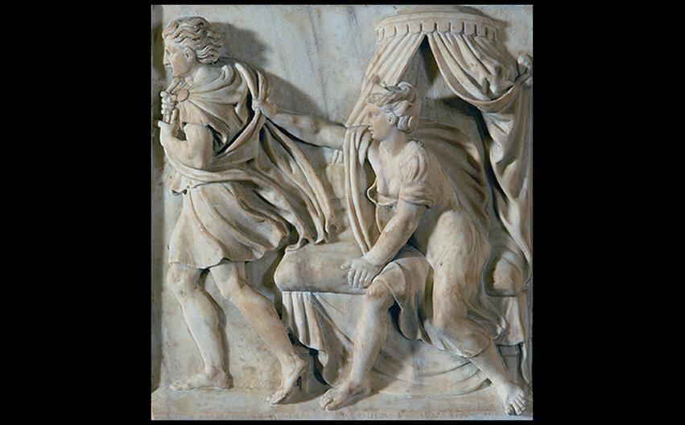
Properzia de' Rossi JOSEPH AND POTIPHAR'S WIFE Cathedral of San Petronio, Bologna. 1525–1526. Marble, 1'9" × 1'11" (54 × 58 cm). Museo de San Petronio, Bologna. Berardi/IKONA.
Notes:
Properzia de' Rossi JOSEPH AND POTIPHAR'S WIFE Cathedral of San Petronio, Bologna. 1525–1526. Marble, 1'9" × 1'11" (54 × 58 cm). Museo de San Petronio, Bologna. Berardi/IKONA.

Slide 54
Venice and the Veneto (1)
Venetians saw themselves as superior to their rivals in Florence and Rome.
The oil-painting technique initiated by the Bellini family was adopted by painters because it was easy to correct errors.
Venetians also covered their walls with sheets of canvas rather than frescoes.

Slide 55
Venice and the Veneto (2)
Giorgione
Although he died from the plague early in life, his contribution to Venetian painting was vast.
Only ten paintings can be attributed to him.
Poesie or enigmatic pastoral themes were inspired by the literary revival of pastoral poetry.

Slide 56
Venice and the Veneto (3)
Giorgione
The Tempest was painted shortly before his death.
A woman in the foreground is nude except for a white cloth over her shoulders.
On the other side, a mysterious man in a soldier's uniform turns his head toward the woman.

Slide 57
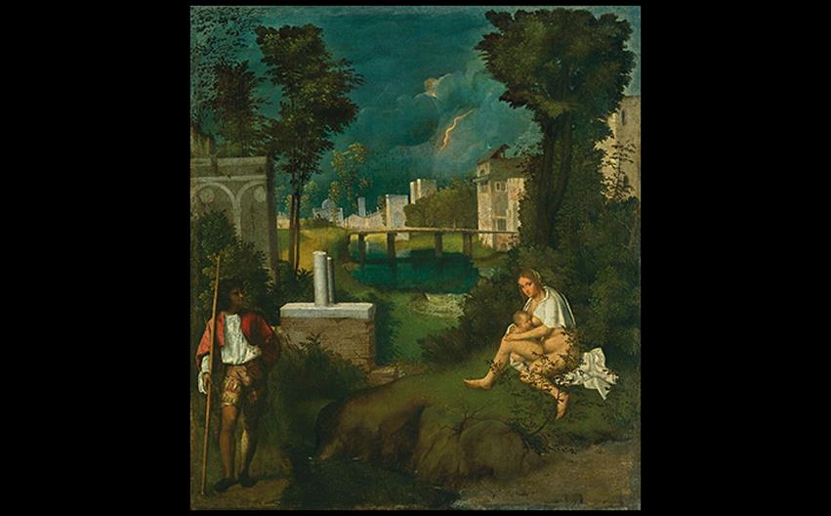
Giorgione THE TEMPEST c. 1506. Oil on canvas, 32" × 28-3/4" (82 × 73 cm). Galleria dell'Accademia, Venice. © Cameraphoto Arte, Venice.
Notes:
Giorgione THE TEMPEST c. 1506. Oil on canvas, 32" × 28-3/4" (82 × 73 cm). Galleria dell'Accademia, Venice. © Cameraphoto Arte, Venice.

Slide 58
Venice and the Veneto (4)
Giorgone
The Pastoral Concert has been attributed to both Titian and Giorgione.
It portrays an idyllic, verdant landscape with two clothed men who seem oblivious to two nude women beside them.
The quality thought to be Titian's is the sensuously painted flesh of the females.

Slide 59
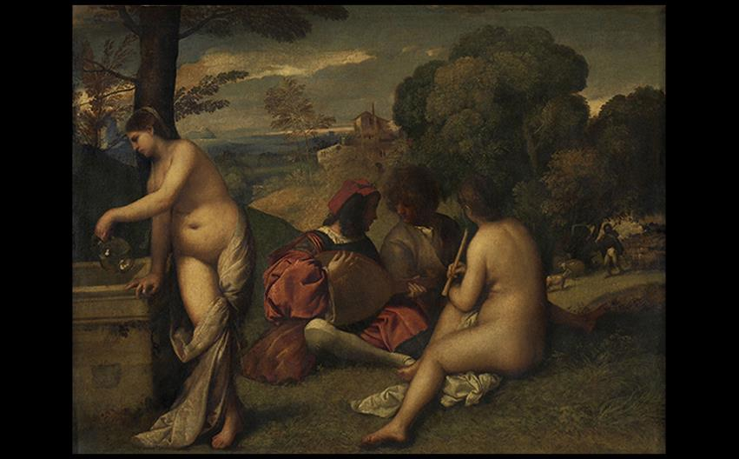
Giorgione or Titian THE PASTORAL CONCERT OR ALLEGORY ON THE INVENTION OF PASTORAL POETRY c. 1510. Oil on canvas, 41-1/4" × 54-3/4" (105 × 136.5 cm). Musée du Louvre, Paris. Photo © Musée du Louvre, Dist. RMN-Grand Palais/Angèle Dequier.
Notes:
Giorgione or Titian THE PASTORAL CONCERT OR ALLEGORY ON THE INVENTION OF PASTORAL POETRY c. 1510. Oil on canvas, 41-1/4" × 54-3/4" (105 × 136.5 cm). Musée du Louvre, Paris. Photo © Musée du Louvre, Dist. RMN-Grand Palais/Angèle Dequier.

